Slide 1

Investment Portfolio Proposal
ADMN 5006 Financial Analytics
Eyas Abu Elhouf, Katrina Ong, Melvin Cheriyan, Pranav Gujar, Bista Bijo, Praveen Kumar

Slide 2

Agenda
Introduction
Economic Outlook
Building an Investment Portfolio
Portfolio Overview
Stock Spotlight
Portfolio Performance
Conclusion

Slide 3

Introduction

Slide 4
Economic Outlook - 2023
Global Economy
Projected global GDP growth: 2.2% (Morgan Stanley)
Narrowly defying recession
U.S.
‘Soft landing’ for the U.S. Economy, with 0.5% GDP growth (Morgan Stanley)
Canada
GDP Forecast: 0.7% (Canadian Government)

Slide 5
Building a stock investment portfolio
Initial List of 23 Stocks Collated from:
Top S&P 500 Stocks
Mid-Cap Companies with High Growth Potential
Popular Stocks from Defensive Sectors/ Industries
Five (5) Stocks were selected by screening:
Analyst Recommendations (sourced from Y! Finance)
Key Financial Ratios (web scraped from Fin Viz)
Industry & Company Analysis
Portfolio Optimization (using FinQuant)

Slide 6
Portfolio overview
Ticker | Company | Sector | Industry
PG | Proctor & Gamble Co. | Consumer Non-Durables | Household/Personal Care
UNH | United Health Group | Health Services | Managed Health Care
WMT | Walmart, Inc. | Retail Trade | Specialty Stores
XOM | Exxon Mobil Corp. | Energy Minerals | Integrated Oil
ENPH | Enphase Energy | Electronic Technology | Semiconductors

Slide 7
Stock Spotlight

Slide 8
Procter & Gamble Co. (PG)
Company Description
Procter & Gamble is an American consumer goods giant, specializing in a wide range of personal care and hygiene products.
P&G is the world's largest consumer packaged goods company, with nearly $84 billion in sales and more than $10 billion in net earnings.
The company’s annual revenue for 2022 was $80.187B, a 5.35% increase from 2021.
Strengths
Global presence
Brand Equity
Weaknesses
Unable to keep up with the frequent change in demand
Closure of brands caused loss
Industry Overview
Consumer Products Industry manufactures and markets everything from food, beverages, toiletries, and small appliances.
The manufacturers in this industry deal with the acquisition of raw materials from suppliers, processing the raw materials to end products for the consumers, and marketing the products to the end customers, distributors, retailers, and wholesalers.
Opportunities
Reach the rural market
Mergers and acquisitions
Threats
High competition
Increased prices of raw materials

Slide 9
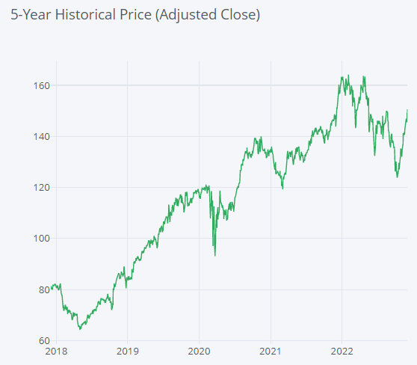
PG
EPS
$5.77
Market Cap
358.85 B
P/E
25.98
Div. Yield
3.65 %

Slide 10
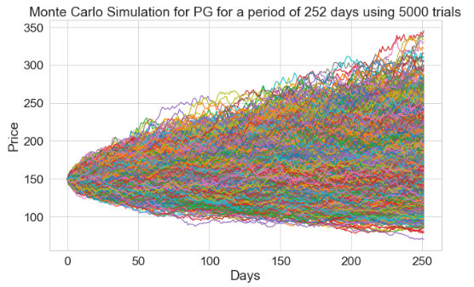
Monte Carlo Simulation for PG
Average Return: 13.32%
Max Return: 131.04%
Min Return: -53.1%
Probability of Attaining Goal of 8.0% Returns: 54.4%
Probability of Going Bust at -5.0% Loss: 24.68%

Slide 11
United Health Group (UNH)
Company Description
UNH is healthcare and insurance company based in Minnetonka, Minnesota. It offers health care products and insurance services. UnitedHealth Group is the world's seventh largest company by revenue and the largest healthcare company by revenue, and the largest insurance company by net premiums.
Strengths
Health care and its role on an aging population.
Protection of capital due to less volatility.
Weaknesses
Cost control and a single payer system.
Industry Overview
Health care is multi-sector. Health care includes nursing homes, medical trials, outsourcing, health coverage, telemedicine, and philanthropic organizations.
Opportunities
Rise of preventive medicines
Threats
Change in policies and rise of preventive medicines.

Slide 12
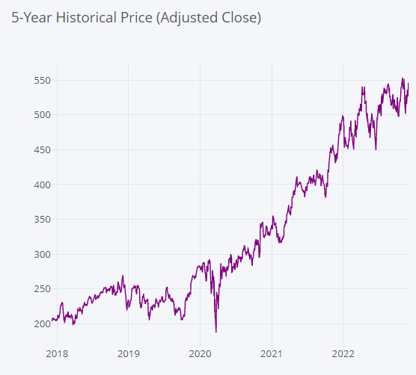
UNH
EPS
$20.42
Market Cap
500.96 B
P/E
26.26
Div. Yield
1.23%

Slide 13
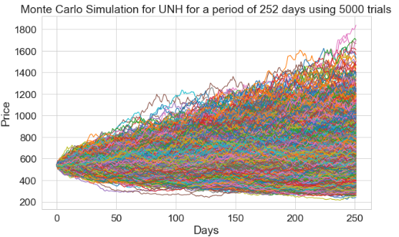
Monte Carlo Simulation for UNH
Average Return: 20.92%
Max Return: 240.94%
Min Return: -55.4%
Probability of Attaining Goal of 8.0% Returns: 59.2%
Probability of Going Bust at -5.0% Loss: 24.62%

Slide 14
WALMART, Inc. (WMT)
Company Description
Found in 1962 by Sam Walton
World’s largest retailer
Y22 Walmart's global net sales - nearly $568 billion
Strengths
Brand Recognition
Efficient Resource Management
Effective adoption of e-commerce
Weaknesses
Thin Profit Margin
Large Span of Control
Industry Overview
Specialty stores are part of the consumer discretionary sector.
Companies in the Specialty Stores industry have grown 46% per year
Opportunities
Demographic Increment
E-commerce Trend
Threats
High Rental Cost
Changing Trends

Slide 15
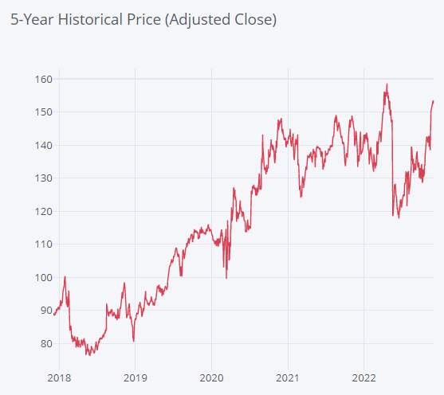
WMT
EPS
3.24
Market Cap
402.12 B
P/E
46.08
Div. Yield
1.50%

Slide 16
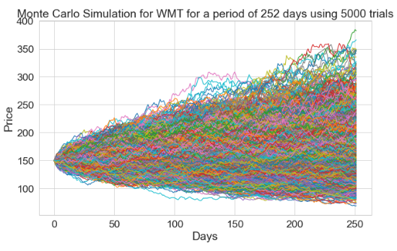
Monte Carlo Simulation for WMT
Average Return: 10.52%
Max Return: 154.98%
Min Return: -53.99%
Probability of Attaining Goal of 8.0% Returns: 48.76%
Probability of Going Bust at -5.0% Loss: 30.7%

Slide 17
Exxon Mobil Corp. (XOM)
Company Description
One of the world’s largest energy providers and chemical manufacturers
Operates facilities and market products all over the world
Reported $23 Billion earnings and $48 Billion cash flow in 2021
Strengths
Great reputation in the industry
Has investments all over the world
Weaknesses
Heavily reliant on fossil fuels
Industry Overview
One of the most important industries that provide energy solutions to other industries
Opportunities
High demand on crude oil and natural gas for energy and raw materials
Threats
Unstable industry that is heavily influenced by politics and regulations
Climate change and the demand to be replaced with renewable energy

Slide 18
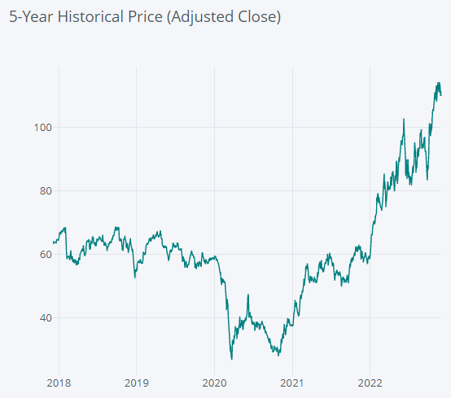
XOM
EPS
$4.68
Market Cap
452.4 Billion USD
P/E
8.64
Div. Yield
3.31%

Slide 19
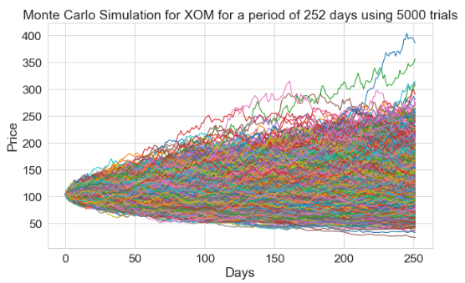
Monte Carlo Simulation for XOM
Average Return: 10.36%
Max Return: 271.87%
Min Return: -77.27%
Probability of Attaining Goal of 8.0% Returns: 46.86%
Probability of Going Bust at -5.0% Loss: 38.28%

Slide 20
EnPhase Energy (ENPH)
Company Description
Develops and manufactures solar micro-inverter battery energy storage, and EV charging stations primarily for residential customers
Strengths
Successful track record of developing new products – product innovation.
Strong distribution network
Superb Performance in New Markets
Weaknesses
There are gaps in the product range sold by the company.
Industry Overview
Semiconductors are essential to almost all sectors of the economy including aerospace, automobiles, communications, clean energy, information technology and medical devices.
Had a global market of USD 527.88 billion in 2021.
Opportunities
Chips will be even more important across all industries, driven by increasing semiconductor content in everything from cars to appliances to factories, in addition to the usual suspects—computers, data centers, and phones.
Threats
Short product life cycles
Long production lead times

Slide 21
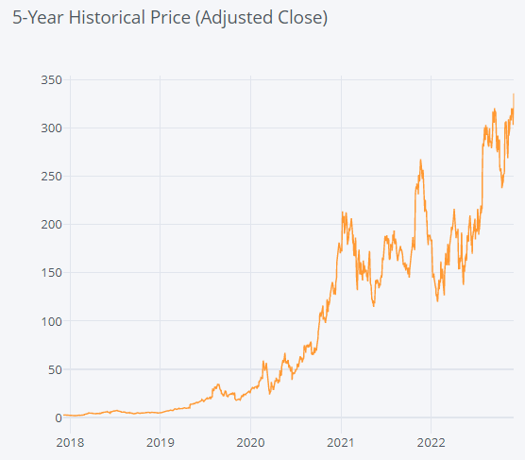
ENPH
EPS
$2.05
Market Cap
$48.09B
P/E
151.09
Div. Yield
0%

Slide 22
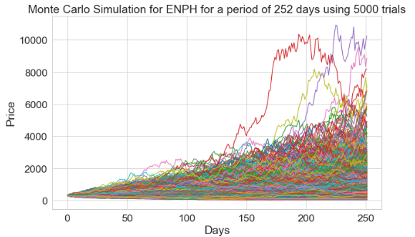
Monte Carlo Simulation for ENPH
Average Return: 156.31%
Max Return: 3209.06%
Min Return: -89.65%
Probability of Attaining Goal of 8.0% Returns: 75.94%
Probability of Going Bust at -5.0% Loss: 19.58%

Slide 23
Portfolio Performance

Slide 24
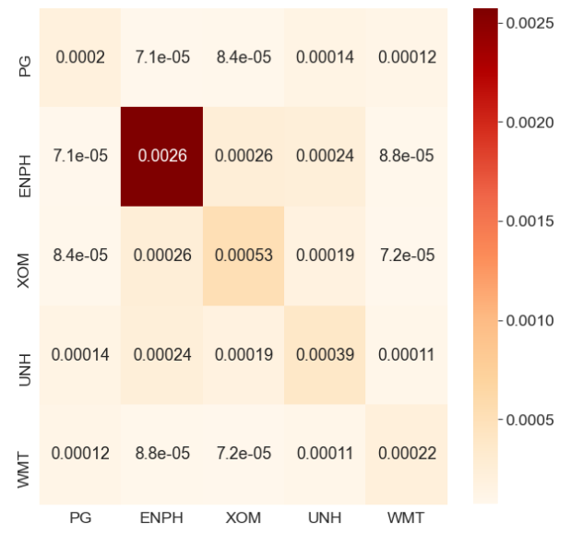
Portfolio covariance
Low Covariance observed between stocks

Slide 25
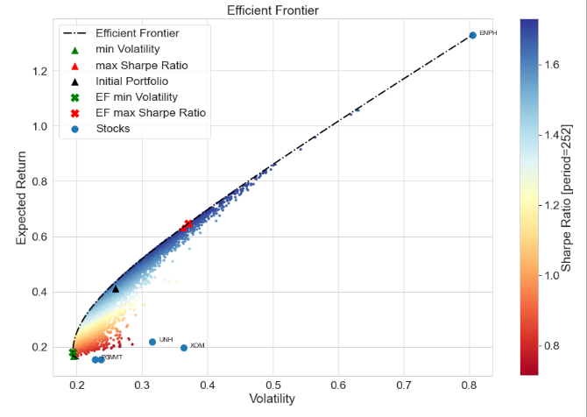
Optimized portfolio
Sharpe Ratio | 1.732
Annual Expected Returns | 0.646
Annual Volatility | 0.370
Ticker | Allocation
PG | 32.77%
ENPH | 41.64%
XOM | 1.41%
UNH | 1.99%
WMT | 22.19%

Slide 26
Conclusion

Slide 27
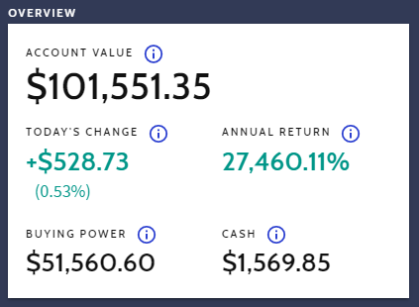
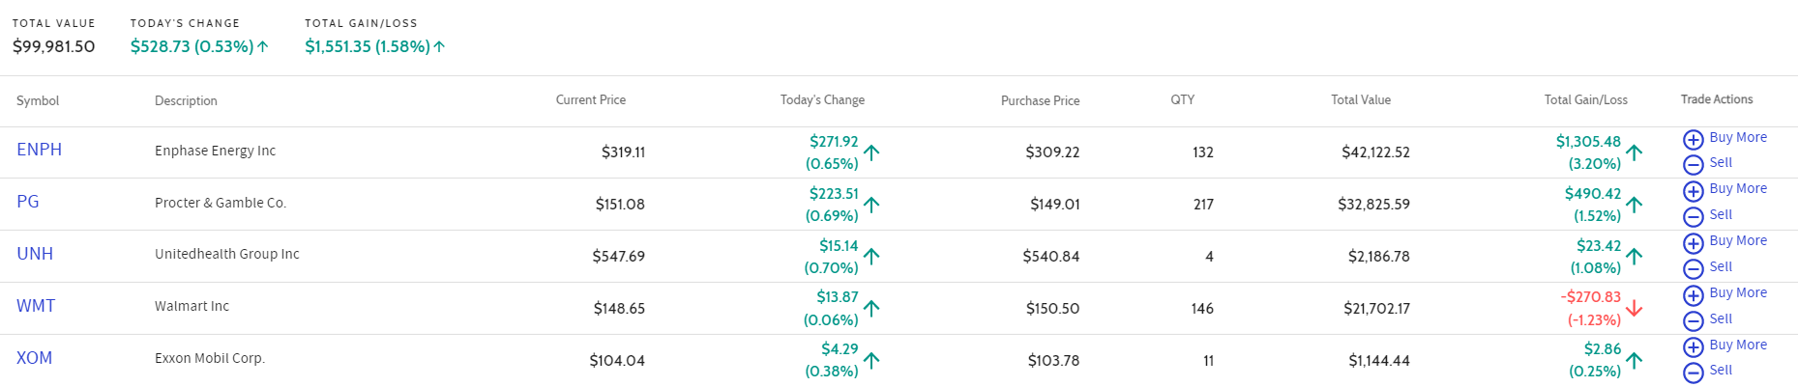
Results of simulation (as of Dec 8)

Slide 28
conclusion
Portfolio diversified through different industries
High expected returns for portfolio, but associated with high risk
Fund can be further managed by allocating a portion of the portfolio for investments and the rest for swing trading

